Slide 1
Vascular meeting
09/11/2022

Slide 2
Agenda
Nicky update
Audit feedback
Case study spread sheet
Valsalva discussion
Infected aorta
Machine trials
Akam crural update

Slide 3

Nicky Update
Isolated CFV incompetence due to SFJ reflux
Suitability for RF ablation.
Scanning all deep veins before squeezing the leg

Slide 4
Audit feedback
Occlusions – decrease colour scale, increase colour gain and use spectral to sample.

Slide 5
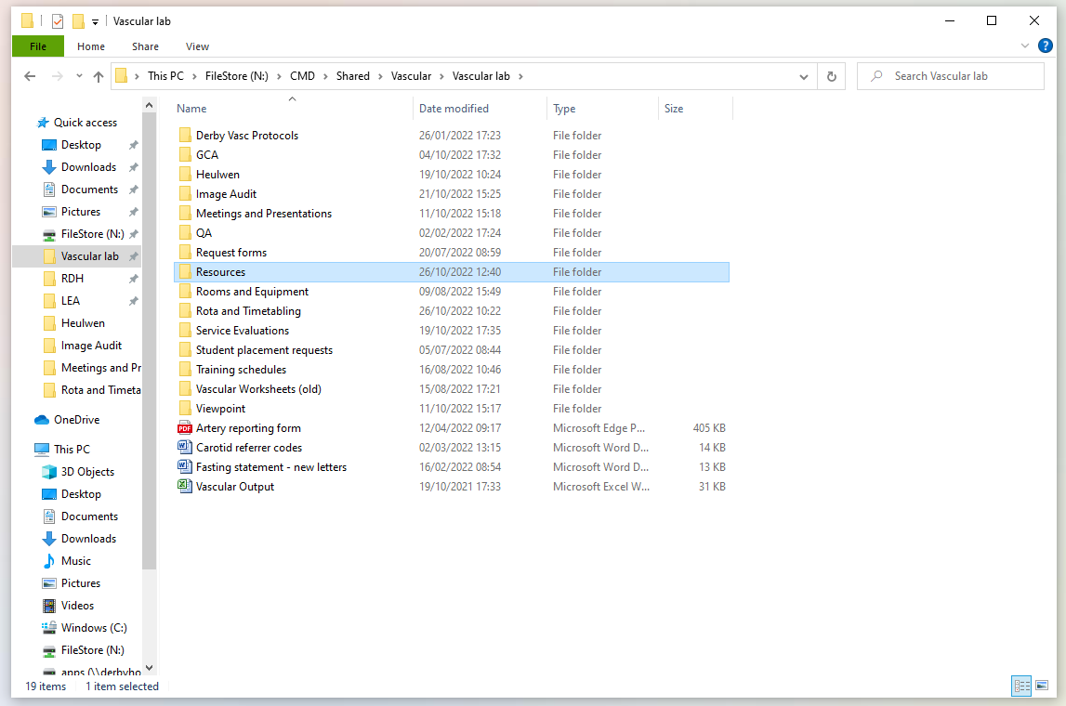
Case study spread sheet
For recording any interesting or rare cases
Hospital number, date, scan and comments
Please input anything you find interesting or you think might be useful for learning

Slide 6
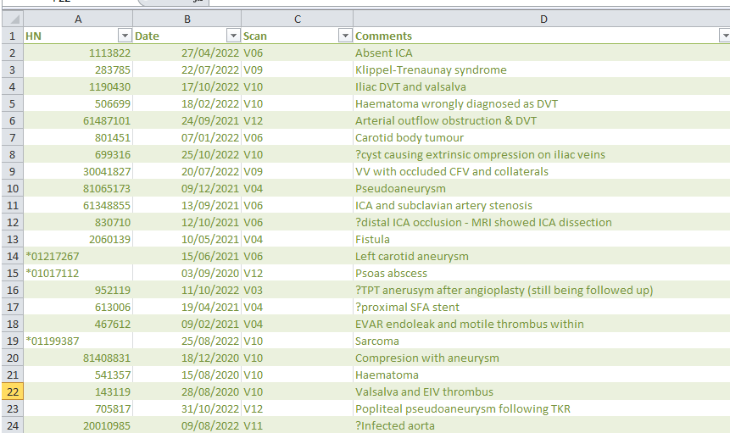

Slide 7
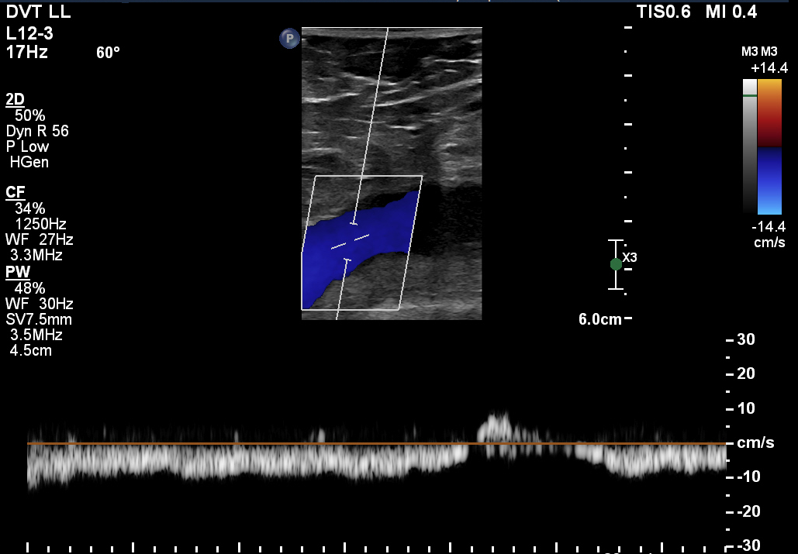
Valsalva discussion
Thoughts on this CFV waveform?

Slide 8
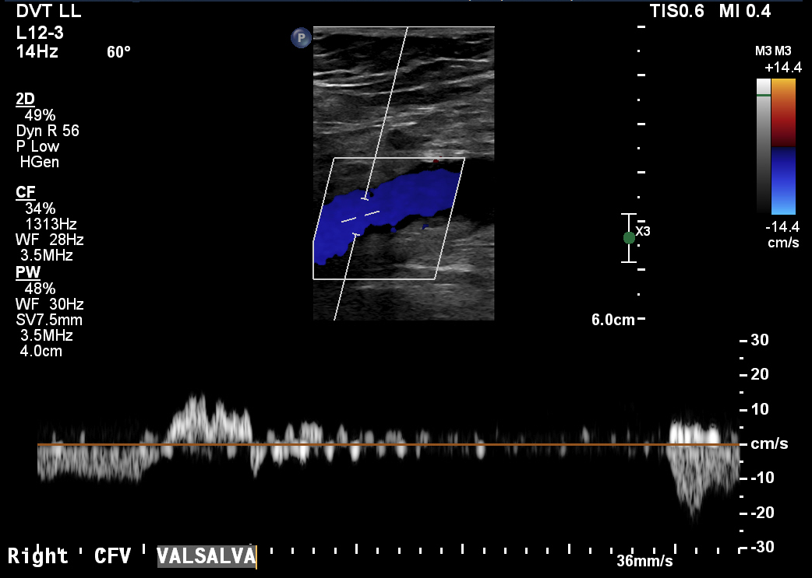
Valsalva discussion
Thoughts on this valsalva?

Slide 9
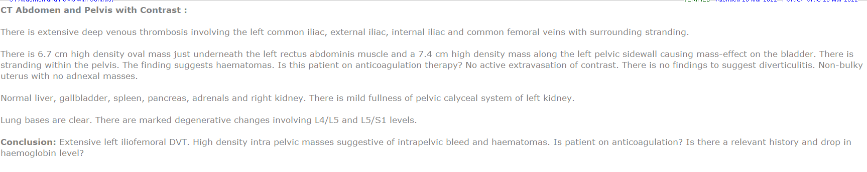
Valsalva discussion

Slide 10
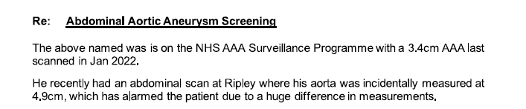
Infected aorta
65 year old male
Came to us for USS aorta due to a large discrepancy in measurements between Jan 2022 and July 22 scans
History of weight loss, back pain, abdominal pain and fever.

Slide 11
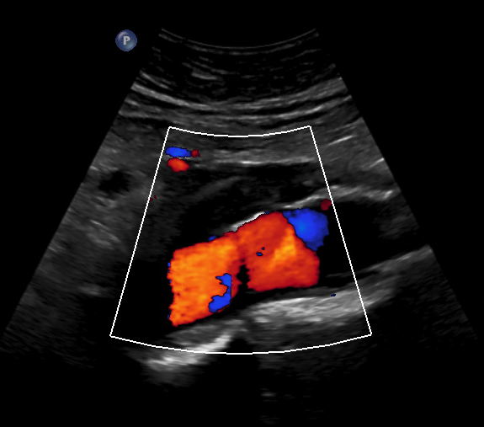
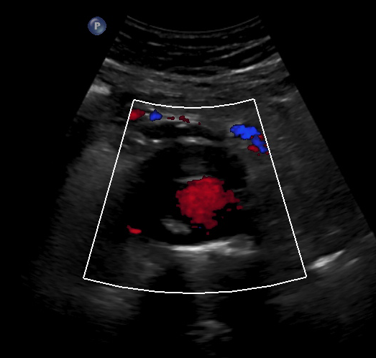
Images

Slide 12
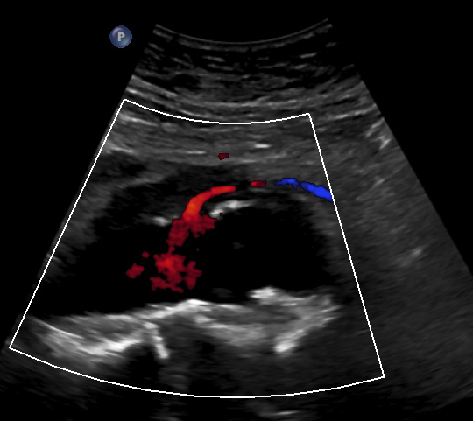
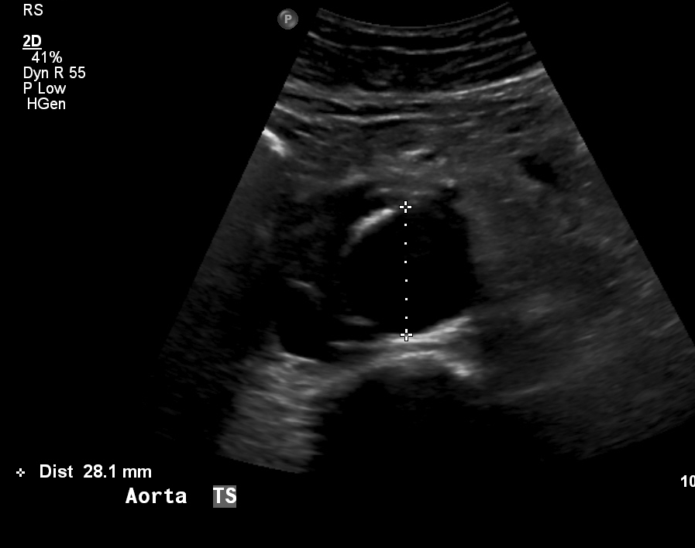
Images

Slide 13
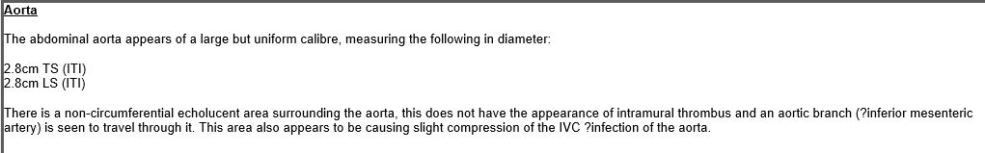
Report
Appearances not convincing of a AAA
There is a vessel which is seen to travel through the region assumed to be mural thrombus

Slide 14
Outcomes
Patient discussed at Vascular MDT
CT images reviewed
Agreement with Vascular US report that images suggest inflammatory changes
Patient to undergo further CT scan and see Mr Quarmby in clinic for bloods to assess for inflammatory markers
Will follow up to see what is concluded from bloods

Slide 15
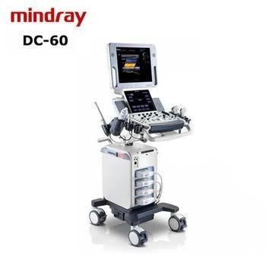
Machine trials
Siemens and GE trials complete
Hoping to get Mindray machine trial in December or January. They are currently having difficulties getting in a Demo to the UK but they should be able to get hold of one in late November.

Slide 16
Feedback: Siemens vs GE portable
Portable (Siemens Juniper) | Score 1 – 5
Manoeuvrability | 5
Ease of use (image optimisation) | 4
Ease of use (labelling, calc package and measurements) | 4
B-mode resolution | 4
Colour filling | 4
Battery | 4.5
Ergonomics (i.e. adjustability) | 4
Portable (GE) | Score 1 – 5
Manoeuvrability | 3
Ease of use (image optimisation) | 3
Ease of use (labelling, calc package and measurements) | 3
B-mode resolution | 4
Colour filling | 4
Battery | 4
Ergonomics (i.e. adjustability) | 4
Average = 4.2
Average = 3.6

Slide 17
Feedback: Siemens vs GE portable
Pros (Siemens)
Able to steer colour-box with tracking ball Good colour-filling (sensitive to lower flow and smaller vessels) Good size and weight of probes Easy to use (basic controls obvious
Pros (GE)
Good colour-filling, particularly with superficial vessels (improvement on the Philips portable) Good range of pre-sets Good image quality when vessels not at depth Good battery life
Cons (Siemens)
Machine doesn’t go high enough Unable to fine steer PW and colour box B-mode resolution struggled at depth
Cons (GE)
Too bulky (long and difficult to steer) Large footprint (for bedside scans) No easier to move around than Philips It is annoying to click buttons for measurements, would be better if this was on a touch screen

Slide 18
Feedback: Siemens vs GE mainframe
Mainframe (Siemens) | Score 1 – 5
Manoeuvrability | N/A
Ease of use (image optimisation) | 4
Ease of use (labelling, calc package and measurements) | 4
B-mode resolution | 3
Colour filling | 4
Ergonomics (i.e. adjustability) | 5
Mainframe (GE) | Score 1 – 5
Manoeuvrability | N/A
Ease of use (image optimisation) | 3
Ease of use (labelling, calc package and measurements) | 3
B-mode resolution | 4
Colour filling | 3
Ergonomics (i.e. adjustability) | 5
Average = 4
Average = 3.6

Slide 19
Feedback: Siemens vs GE mainframe
Pros (Siemens)
Able to steer colour-box with tracking ball Good colour-filling (sensitive to lower flow and smaller vessels) Good size and weight of probes Easy to use (basic controls obvious)
Pros (GE)
Being able to change the frequency of B-mode and colour is good Easily able to adjust height, position etc of monitors (good ergonomically) Able to overwrite image labels Good B-mode image resolution
Cons (Siemens)
Grainy B-mode images which needs some tweaking – occasions when image wasn’t that clear Colour bleeds too much (especially on arterial – hard to get balance between wall to wall filling and colour bleeding) Sometimes labels don’t overwrite when cursor is moved
Cons (GE)
Buttons are hard to press Cannot get filling in calcified crural vessels even when optimising all controls Calc package not displayed on screen Too many buttons – it is fiddly to optimise images

Slide 20
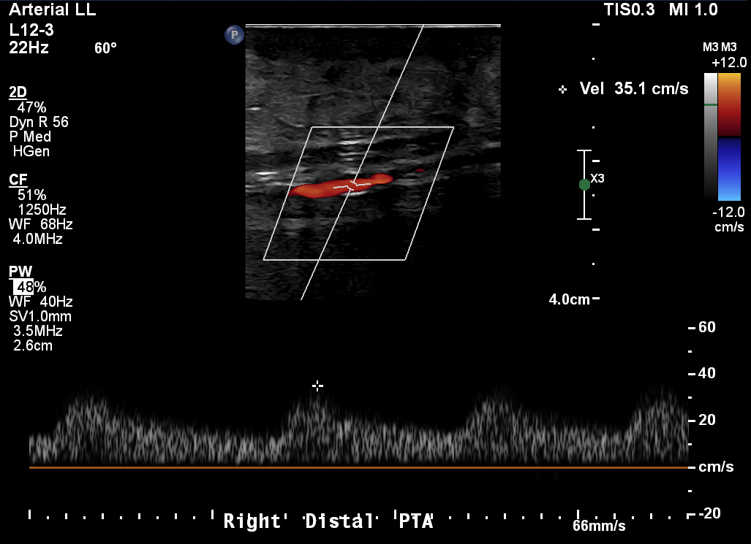
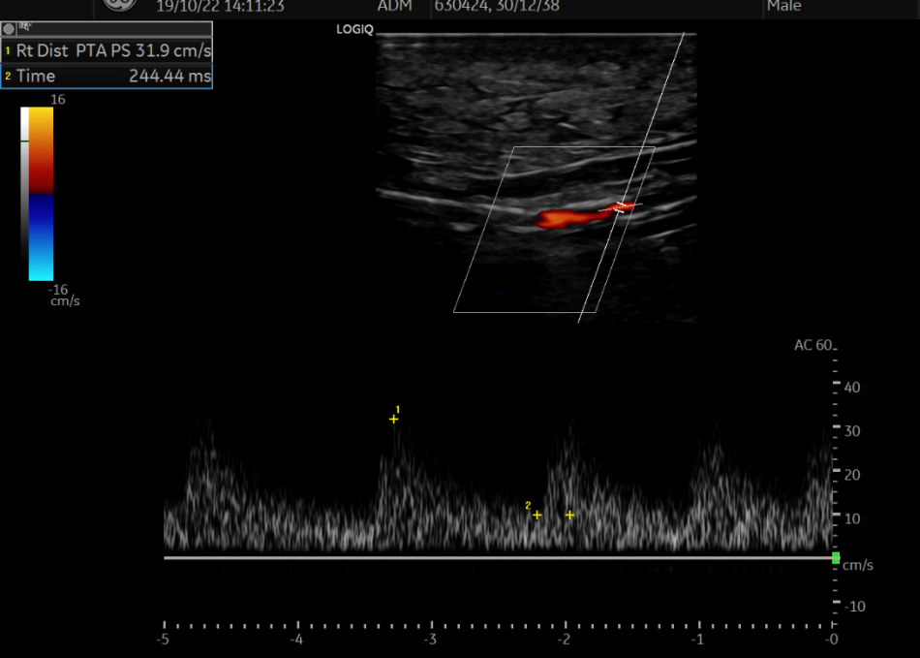
Philips vs GE

Slide 21
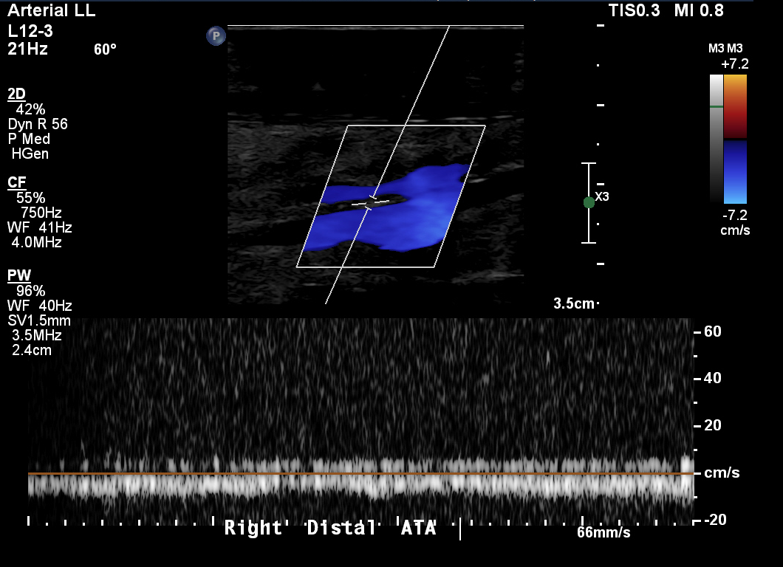
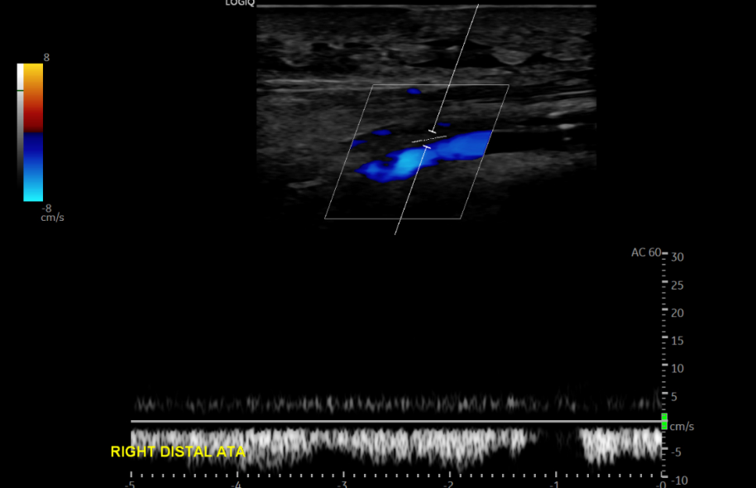
Philips vs GE

Slide 22
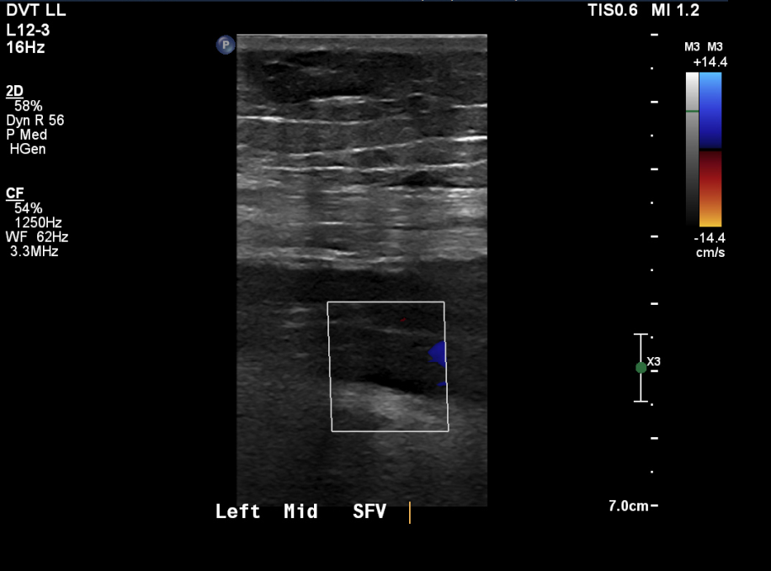
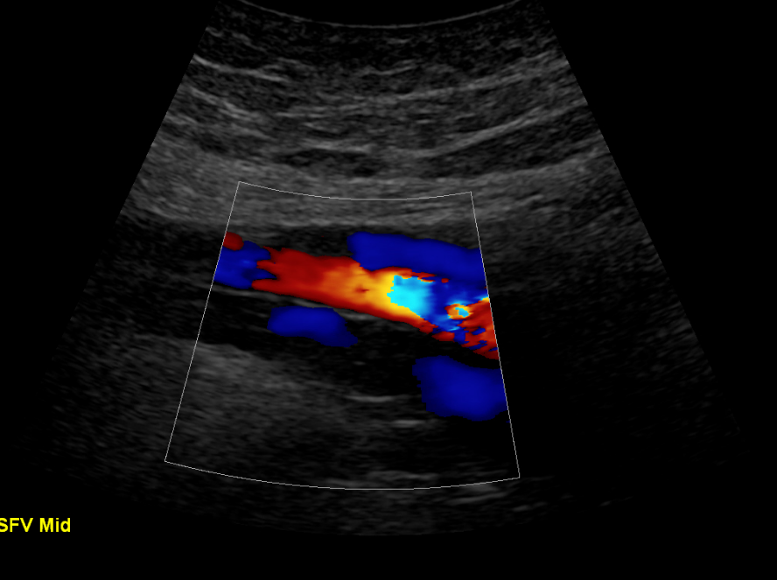
Philips vs GE

Slide 23
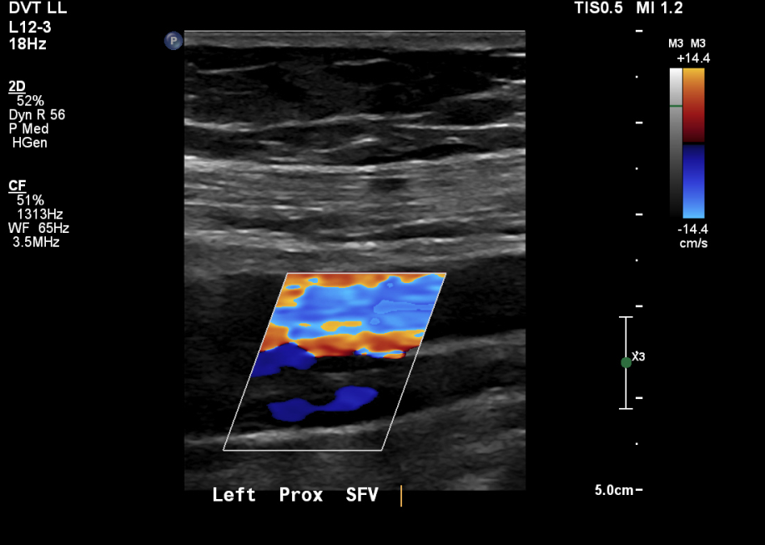
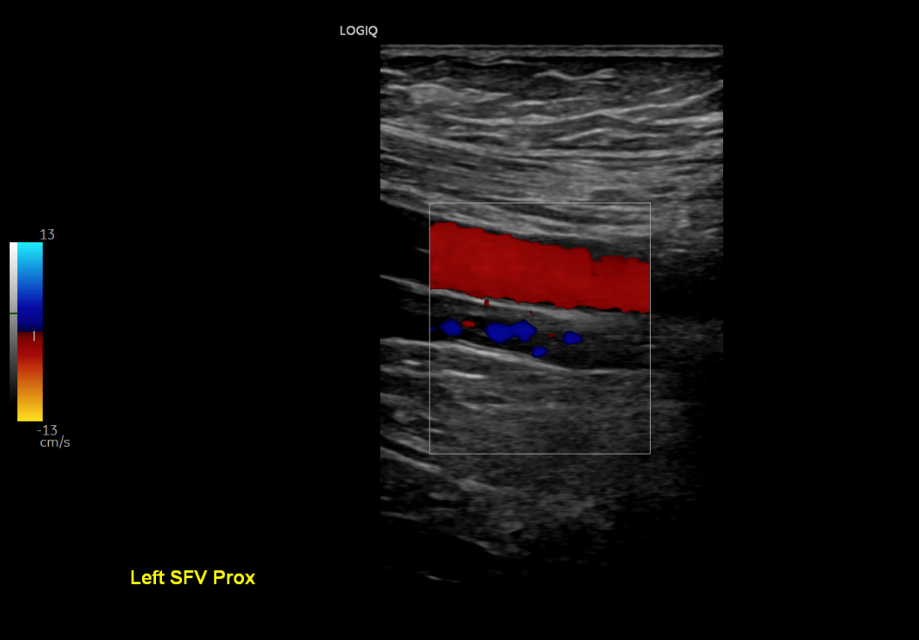
Philips vs GE

Slide 24
Feedback
Both Siemens and GE have said that we could do a follow up demo in the new year to iron out any concerns we had.
Siemens said the issue with the B-mode image quality could be addressed.

Slide 25
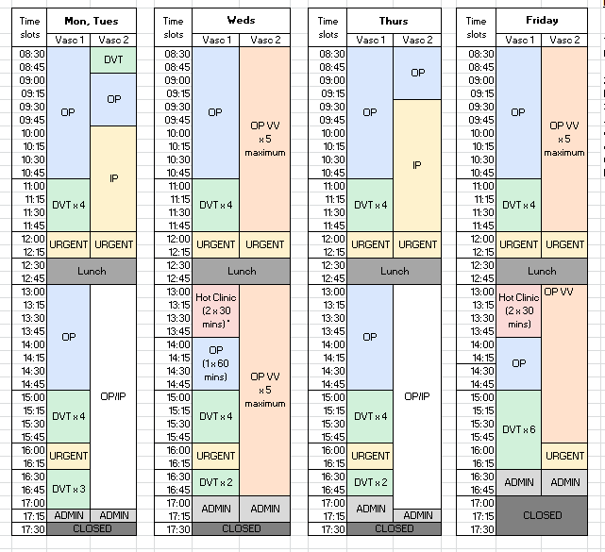
Scan timetable
1) Move the underused 08:30 urgent slot to 12:00 (the most used)
2) 5 Maximum VVs per session
3) Move the awkward Urgent slot on Friday, extending the awkward 30 minutes OP slot
3) Regular small staff meet Monday end of day rather than start
Staff meet

Slide 26
SVTGBI scan slot duration guidelines
Will be made available on the website post conference
Released as 2 documents. One is a listed recommended time scale per scan. Another is a list of considerations.

Slide 27
SVTGBI scan slot duration guidelines
Scan type |  | Scan time slots
 |  | RDH | SVT
V01 | ABPI | 30 | 30
V02 | E-ABPI | 30 | 45
V03 | Graft | 45 | 45
V04 | LEA | 45 | 45
V05 | LEA bilat | 60 | 60
V06 | Carotid | 30 | 30
V07 | UEA | 30 | 45
V08 | Vein map | 30 | 30
V09 | VV | 40 | 45
V09a | VV bilat | 40 | 60
V10 | DVT | 15 | 30
V11 | AAA | 20 | 30
V12 | DVT | 20 | 30
V13 | GCA | 30 | 30
V15 | UEV | 30
V20 | DVT (Rescan) | 15 | 30
However this is for Aorta to ankle
However this is for full limb including calf
For more thorough examination ? Iliacs etc
General comments:
All quoted values refer to a range up to the maximum time per scan

Slide 28
DVT clinic stats

Slide 29
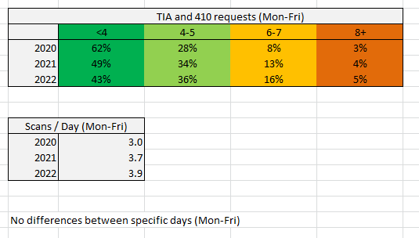
TIA clinic
% of days where the following amount of scans were performed

Slide 30
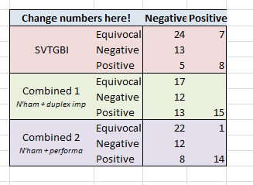
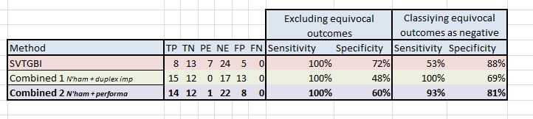
GCA
Biopsy
US
US
US
Circumferential vs Halo
? Healed vasculitis

Slide 31
Brief snapshot of our current workload

