Slide 1
Agenda
Bacon sandwiches
Common femoral vein waveforms
Insert lists (+/- modifications)
Plaque characteristics
Audit themes
Trainees updates
Any other miscellaneous business

Slide 2

Venous Waveforms

Slide 3
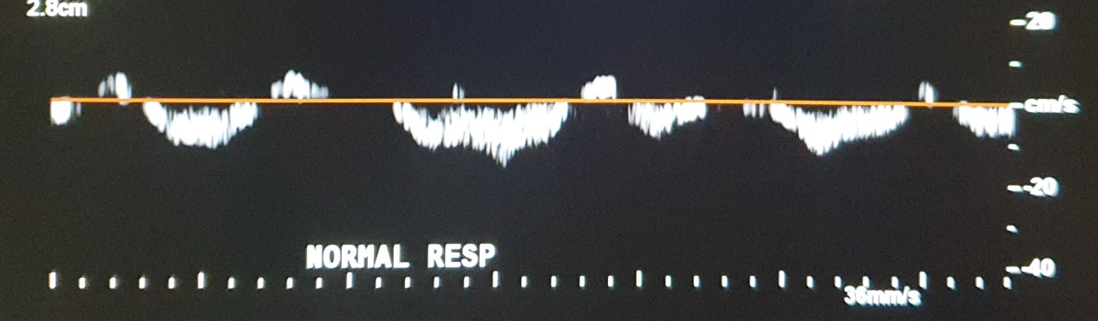
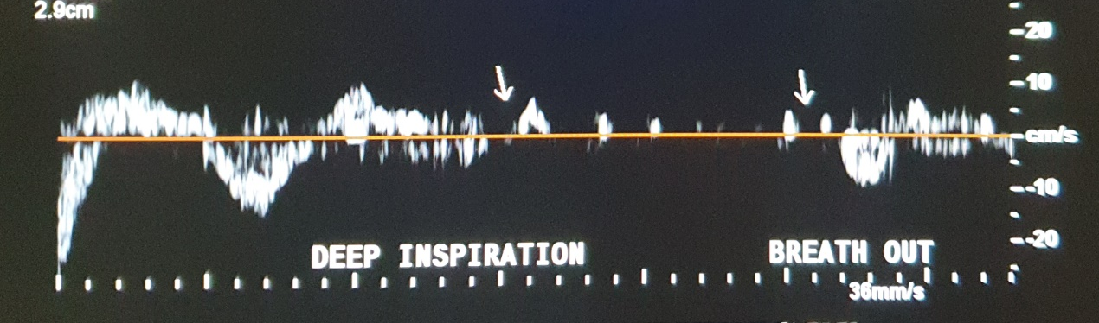
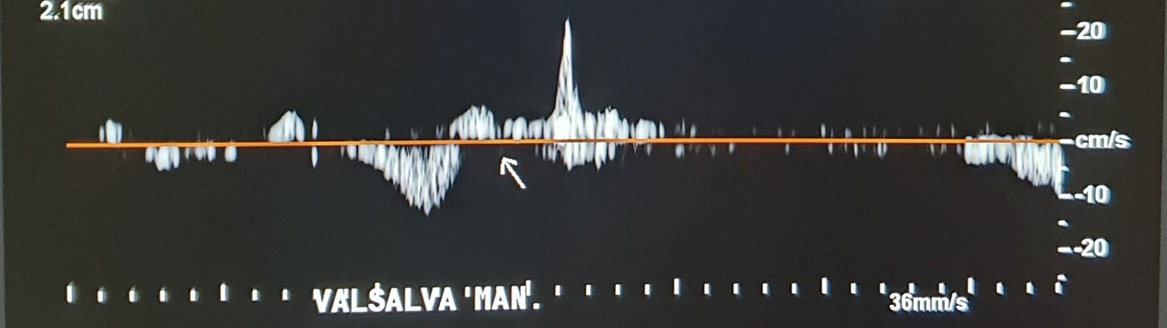
Venous Waveforms

Slide 4
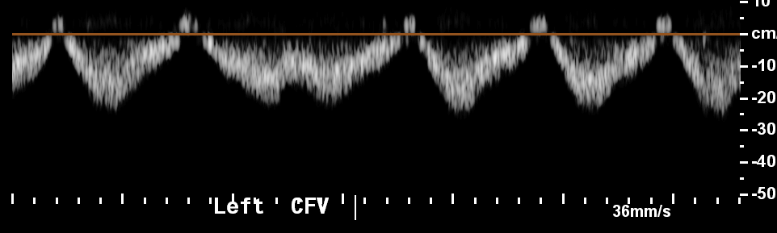
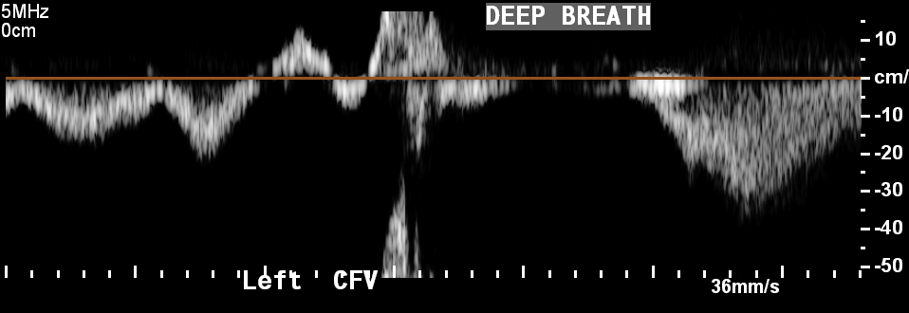
Venous Waveforms

Slide 5
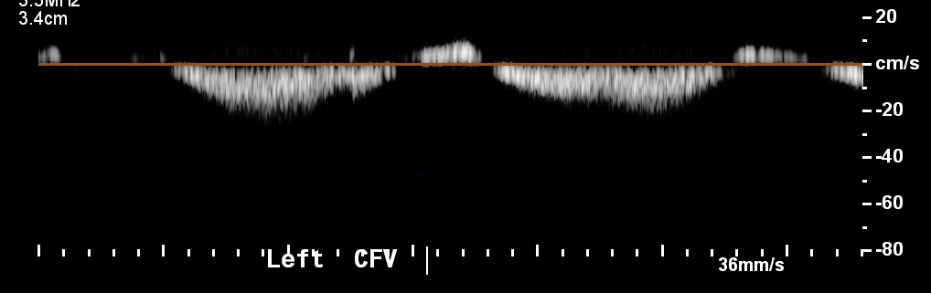
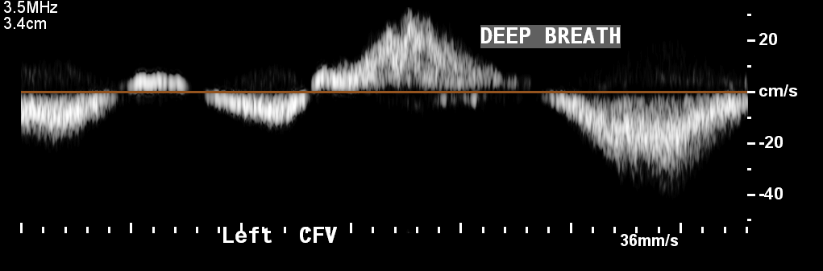
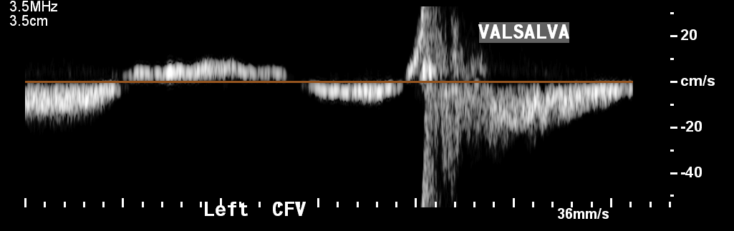
Venous Waveforms

Slide 6
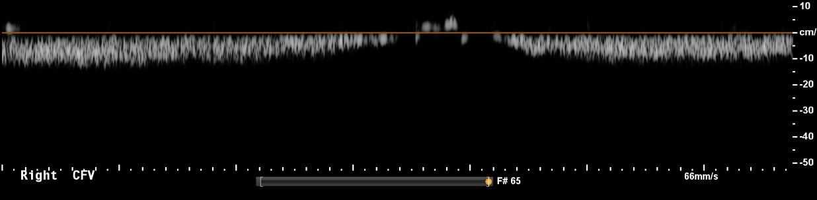
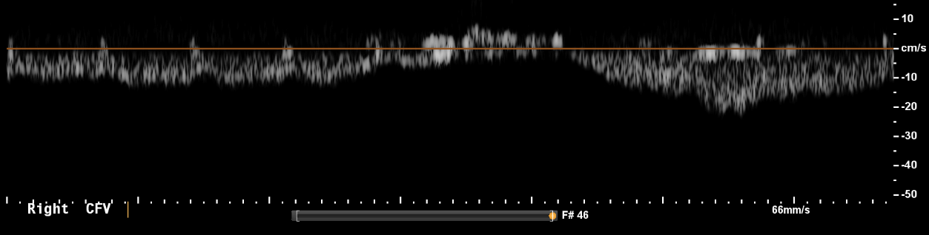
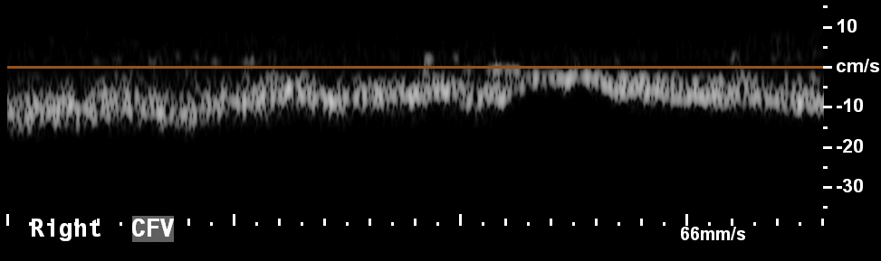
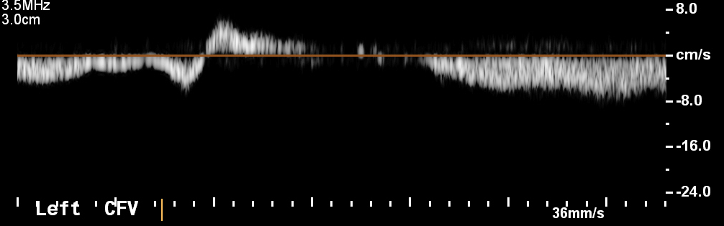
27/10/2020
03/11/2020
22/12/2020
INSPIRATION
SAME
PATIENT

Slide 7
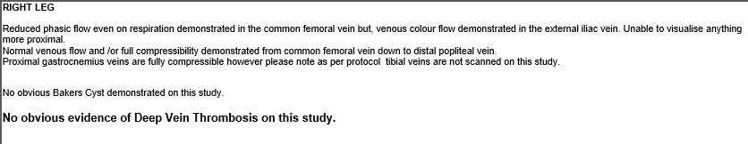
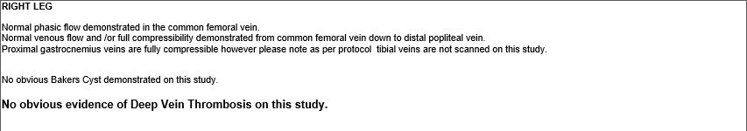
CFV Waveforms
27/10/2020
03/11/2020

Slide 8
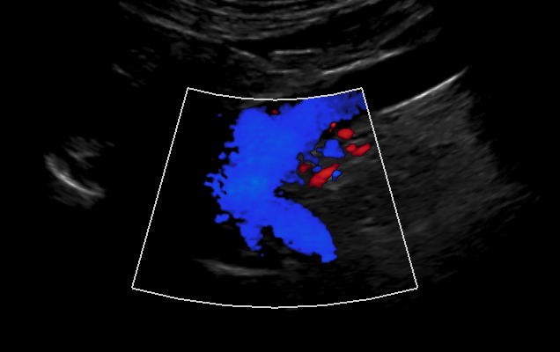
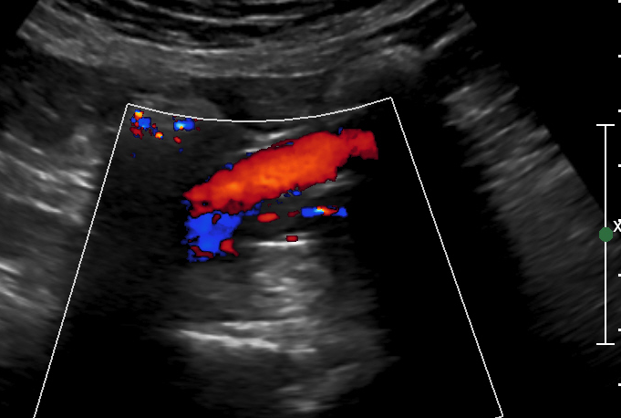
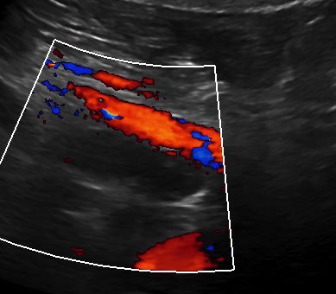
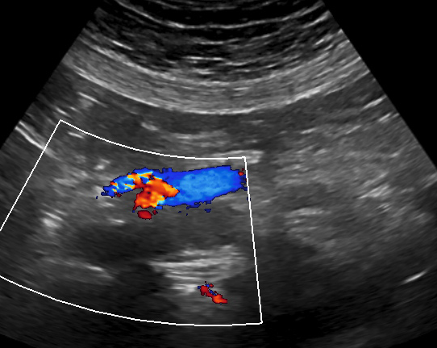
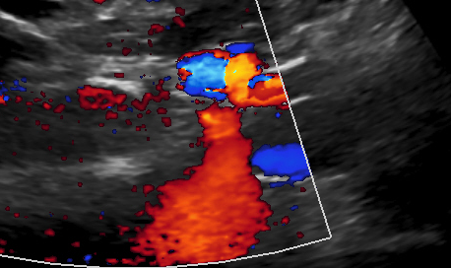
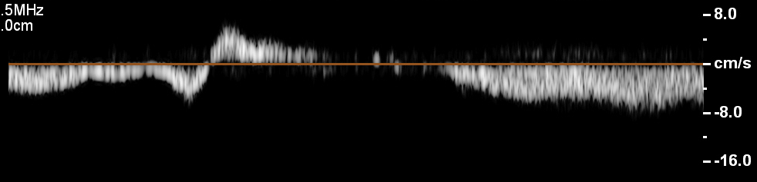
CFV Waveforms
Right CFV
22/12/2020
Right EIV
Right CIV (distal)
Right CIV (prox)
? IVC
Left CIV
Right CIV
Left CFV

Slide 9
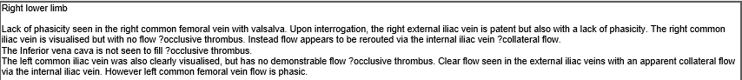
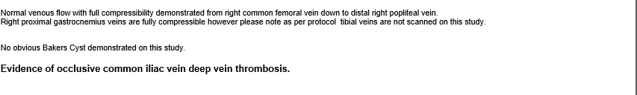
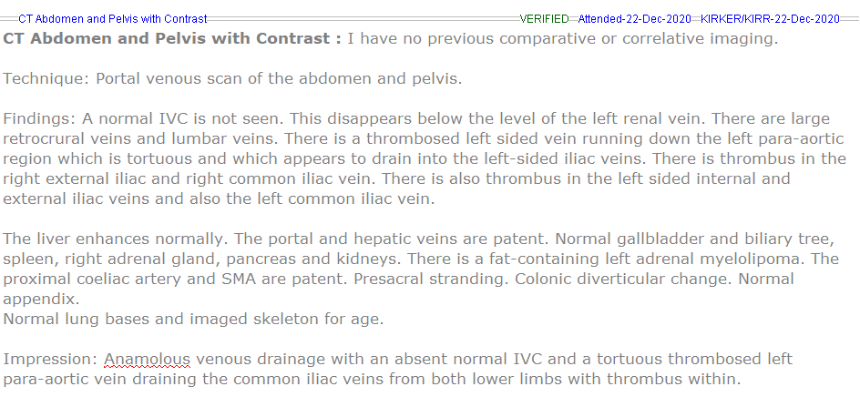
Right EIV
Right CIV (distal)
? IVC
Left CIV
Right CIV

Slide 10
27/10/2020
ABNORMAL
VENOUS WAVEFORMS?
03/11/2020
?
22/12/2020

Slide 11
Patient 1 (Ryan)
Myeloma
Active cancer
Immobile
3 week worsening pain with progressive left leg swelling
?Left lower limb DVT

Slide 12
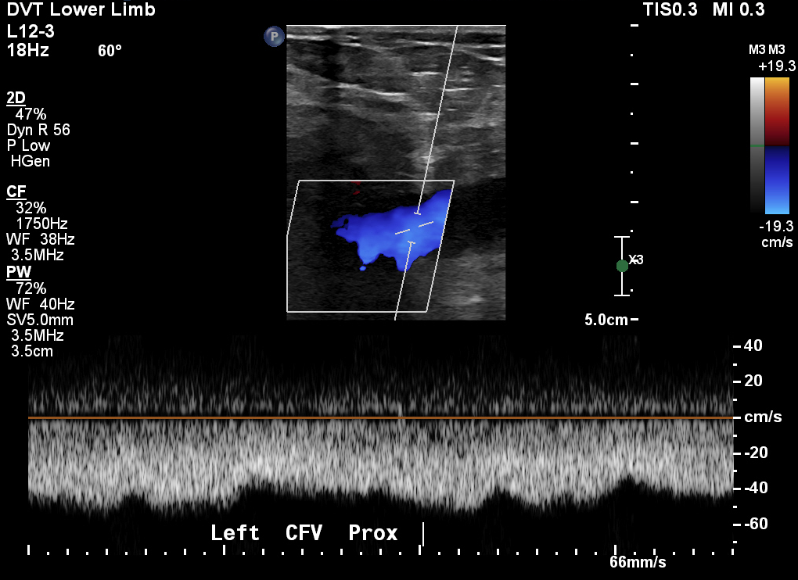
Patient 1

Slide 13
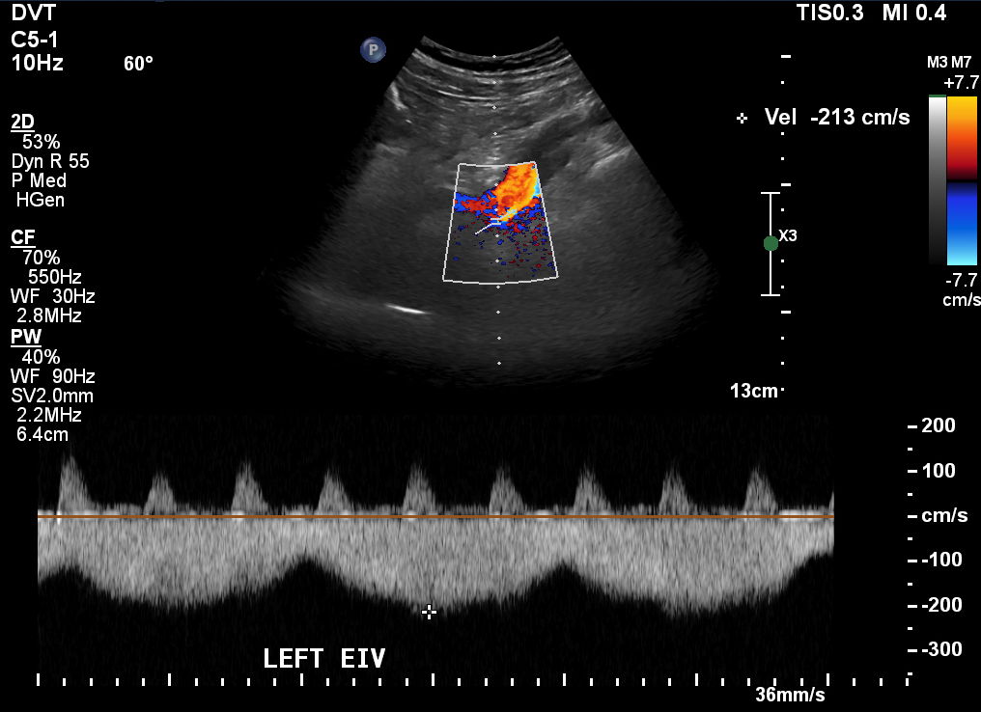
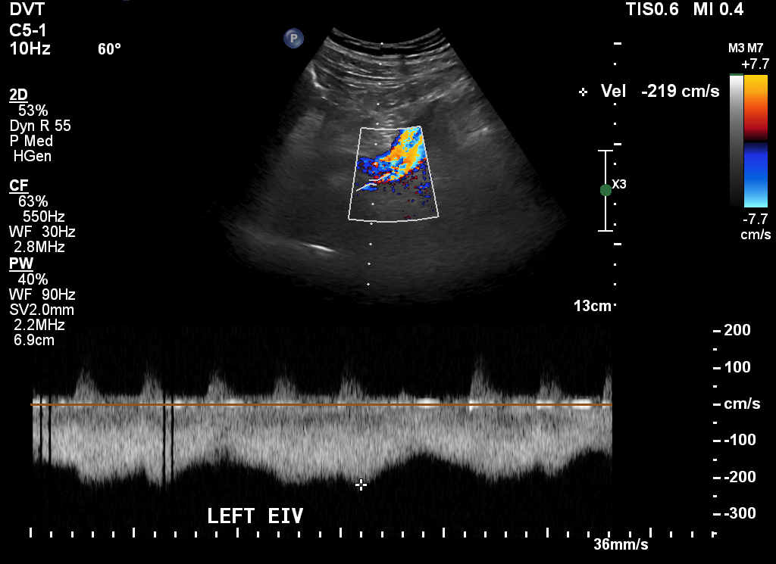
Normal lower limb scan (-ve DVT)
Patient 1
213 cm/s
219 cm/s

Slide 14
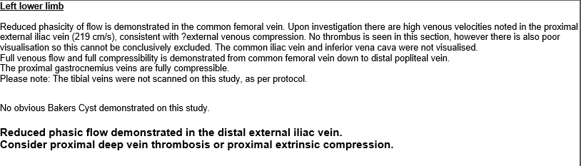
219 cm/s

Slide 15
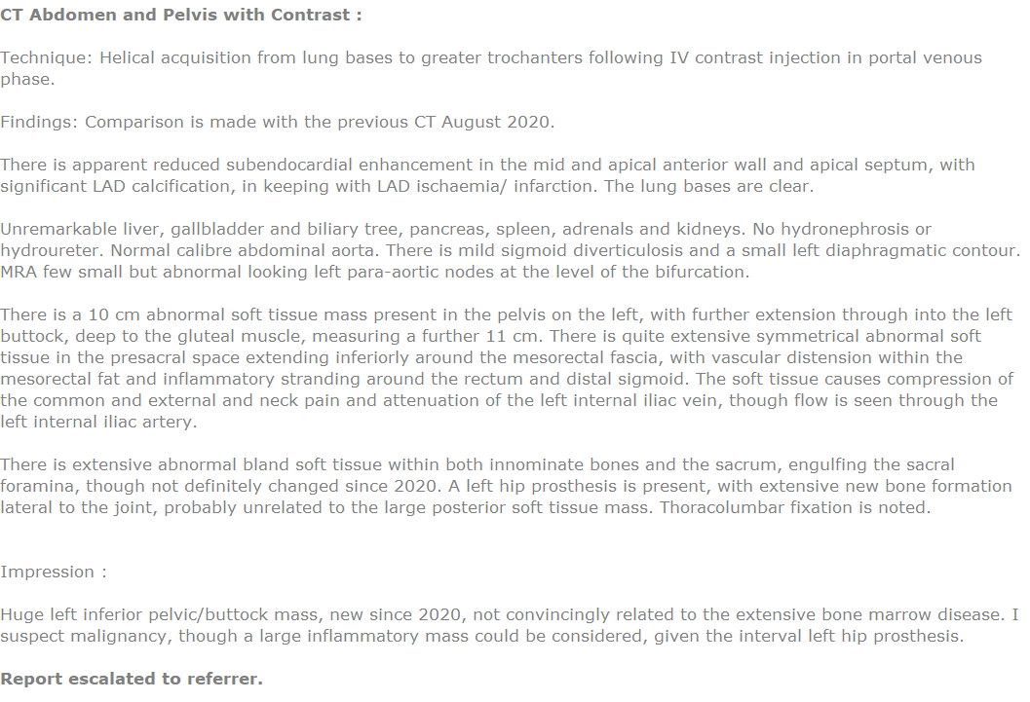
CT Report

Slide 16
So………………………. 1. What is phasic flow? 2. What is reduced phasicity? 3. What is aphasic flow?

Slide 17
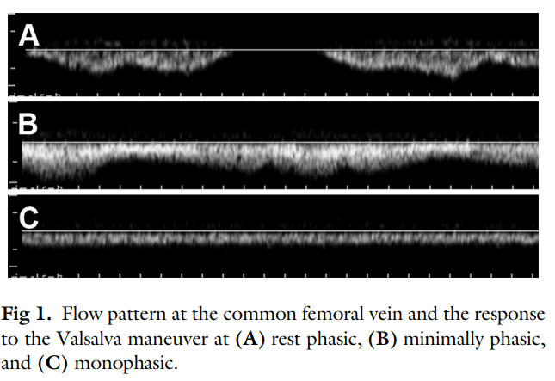
CFV flow patterns
Phasic: Cessation of flow correlated with respiration
Minimally Phasic: Some phasicity but no cessation during respiration
Monophasic: Continuously flattened.
THIS IS NOT WITH A DEEP BREATH IN
Kayilioglu et al., 2015

Slide 18
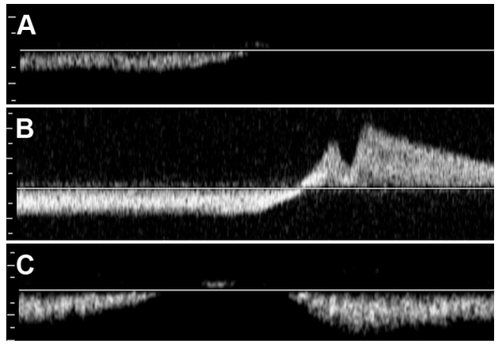
CFV flow patterns (Valsalva)
Complete cessation.
Reversal of flow (reflux)
Unceasing forward flow during valsalva.
Kayilioglu et al., 2015

Slide 19
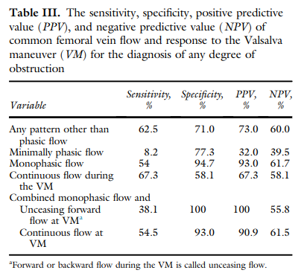
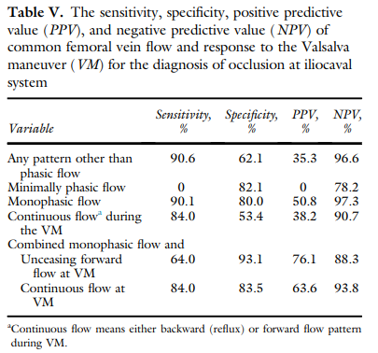
Summary
Sensitivity of monophasic flow increases as degree of obstruction increases.
There is a high specificity for aphasic “flat” venous flow during normal normal respiration.
Performing a valsalva manoeuvre in patients with flat venous flow provides greater clarity!

Slide 20
CFV flow patterns to keep an eye out for
NORMAL RESPIRATION: Monophasic - Continuously flattened.
VALSALVA MANEOUVRE: Unceasing forward flow during valsalva.
Kayilioglu et al., 2015

Slide 21
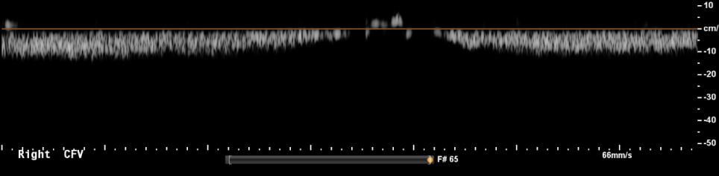

CFV flow patterns to keep an eye out for
NORMAL RESPIRATION: Monophasic - Continuously flattened.
Does a deep inspiration (rather than Valsalva) hide aphasic venous flow during normal respiration, and reduce our reporting of ?iliac obstruction…?
Kayilioglu et al., 2015

Slide 22
But what about…
NORMAL RESPIRATION: Minimally Phasic- Some phasicity but no cessation during respiration
“Explaining the mechanism of the minimally phasic flow pattern in femoral veins is difficult… This can be caused by respiratory factors. However the diagnostic value for this type of pattern for ilio-caval obstruction was very low.”
“Combining this with the criteria for response to the Valsalva manoeuvre was not associated with higher diagnostic value”
Kayilioglu et al., 2015

Slide 23
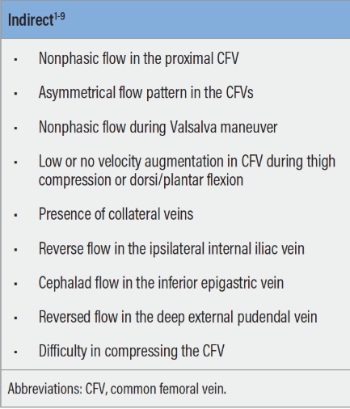
!
Removes central respiratory causes as possible aetiology.
!
Demonstrates presence of outflow obstruction if ‘flow’ cannot increase in response.
!
We do this anyway…
…..Scan proximally if possible?

Slide 24
Reporting
If the venous flow is ipsilaterally and unilaterally aphasic, then report ?proximal occlusion or extrinsic compression.
This might have given this gentleman an earlier diagnosis and treatment!
BUT….. If you can see proximally say what you see.

Slide 25

Follow up
Asking Dr. T.L for patients that have had ilio-caval DVTs and retrospectively assess the CFV flow (if we performed DVT scans on these patients).
New protocol?
Lets wait and see.

Slide 26

Insert lists

Slide 27
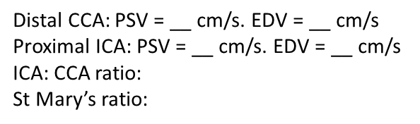
Carotids
“New”
__ side
​
The common carotid artery is patent with no significant atheroma or thickening of the intima-media layer. PSV within normal limits.
The internal carotid artery is patent with no significant atheroma seen. PSV within normal limits.
The external carotid artery is patent with no significant atheroma seen.
Antegrade vertebral flow.
All measurements and velocities are based upon the NASCET criteria.
Echolucent : Soft
Mixed echogenicity : Mixed
Calcified

Slide 28
Carotids
“New significant”
__ side
​
The common carotid artery (CCA) is patent with no significant arterial disease seen. There is mild ___ atheroma and thickening of the intima-media layer in the distal CCA (__ mm).
There is a significant __ % stenosis in the proximal internal carotid artery (ICA). This has a ___ and ____ plaque morphology and begins at the ____ and extends into the ICA for a ___ cm length. No atheroma is seen in the distal ICA at the level of the jawline.
The external carotid artery (ECA) contains mild ___ atheroma proximally, however this is not haemodynamically significant.
Antegrade vertebral flow.
​
Distal CCA: PSV = __ cm/s. EDV = __ cm/s
Proximal ICA: PSV = __ cm/s. EDV = __ cm/s
ICA: CCA ratio:
St Mary’s ratio:
All measurements and velocities are based upon the NASCET criteria.

Slide 29
LEA
“New”
Clinical presentation:
Medications:
Aorto-iliac segment Aorta: Patent with no significant stenosis seen, and is of normal and uniform calibre throughout. __ waveforms, PSV = __ m/s. __ CIA: Patent with no significant stenosis seen. __ waveforms, PSV = __ m/s.
__ EIA: Patent with no significant stenosis seen. __ waveforms, PSV = __ m/s.
___ lower limb
CFA: Patent with no significant arterial disease seen, ___ waveforms, PSV= __ m/s.
PFA: Patent at origin with no significant arterial disease seen proximally.
SFA: Patent. No significant arterial disease seen. ___ waveforms throughout, PSVs: proximal = __ m/s, mid = __ m/s, distal = __ m/s. The vessel is patent throughout the adductor canal.
POPA: Patent. No significant arterial disease seen. ___ waveforms, PSVs: proximal = __ m/s, distal = __ m/s.
TPT: Patent with no significant arterial disease seen. ___ waveforms, PSV= __ m/s.
Crural arteries
PTA: Patent throughout with no significant disease seen. __ waveforms throughout, distal PSV = __ m/s. ATA: Patent throughout with no significant disease seen. __ waveforms throughout, distal PSV = __ m/s. PEROA: Patent throughout with no significant disease seen. __ waveforms throughout, distal PSV = __ m/s.
Summary
☺
☹

Slide 30
Graft (new)
___ lower limb
Clinical presentation:
Clinical history:
Medications:
​
​
The graft is seen to originate from the ___ and inserts into the ___.
___ (graft inflow): Patent with no significant arterial disease seen. __ waveforms, PSV __ m/s.
Proximal anastomosis: Patent with no atheroma seen. __ waveforms, PSV __ m/s.
Proximal graft: Patent with no atheroma seen. __ waveforms, PSV __ m/s.
Mid graft: Patent with no atheroma seen. __ waveforms, PSV __ m/s.
Distal graft: Patent with no atheroma seen. __ waveforms, PSV __ m/s.
Distal anastomosis: Patent with no atheroma seen. __ waveforms, PSV __ m/s.
____ (graft outflow): Patent with no significant arterial disease seen. __ waveforms, PSV __ m/s.
​
Summary:
There are no significant changes in velocities or waveforms since the last scan in ___.
The next graft surveillance scan is planned for ___.

Slide 31
VV
“New”
__ Lower Limb
The deep venous system is patent and competent from CFV-POPV.
The SFJ is incompetent. The LSV is incompetent throughout the thigh and proximal calf where it measures the following in diameter: proximal thigh: __mm, mid thigh: __mm, distal thigh: __mm, proximal calf: __mm. The LSV is straight throughout this section, contains no superficial thrombophlebitis and would be suitable for endovenous ablation. A VV arises from the LSV in the ___ thigh, and this courses ___ through the calf.
The anterior circumflex thigh vein is incompetent, measuring __mm in diameter in the proximal thigh. This supplies a VV in the __ thigh that courses ___ throughout the calf.
The SPJ is incompetent and is located __cm proximally to the knee crease. The SSV is incompetent throughout its length, measuring the following in diameter: proximal calf: __mm, mid calf: __mm, distal calf: __mm. It is straight throughout this section with no superficial thrombophlebitis and would be suitable for endovenous ablation. The SSV supplies a VV in the __ thigh that courses ___ throughout the calf.
There is an incompetent __ to __ perforator in the __ that measures __mm in diameter.

Slide 32
DVT
“New”
___ lower limb Normal phasic flow is demonstrated in the common femoral vein. Normal venous flow and /or full compressibility is demonstrated from common femoral vein down to distal popliteal vein. The proximal gastrocnemius veins are fully compressible. Please note: The tibial veins were not scanned on this study, as per protocol. No obvious Bakers Cyst demonstrated on this study. This study is negative for deep vein thrombosis
___ upper limb There is normal venous flow and/or full compressibility demonstrated in the deep venous system from the proximal subclavian vein to the distal radial and ulnar veins.
The cephalic and basilic veins are patent and compressible throughout their length. This study is negative for deep vein thrombosis

Slide 33
Carotid plaque characterisation

Slide 34
Why?
TIA causes are embolic rather than haemodynamic.
Until >95% stenosis when there may be a distal ICA collapse (with trickle flow).
A high risk plaque may not be related to the degree of stenosis.
Is it important to be able to distinguish low vs high risk plaques for emboli generation?
Especially for <70% and/or asymptomatic stenoses where the risk is lower.
For these, the number needed to treat (NNT) to prevent a stroke is higher.
For example… the NNT for asymptomatic patients at 5 years is 20…

Slide 35
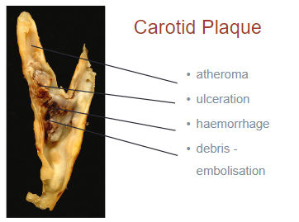

Slide 36
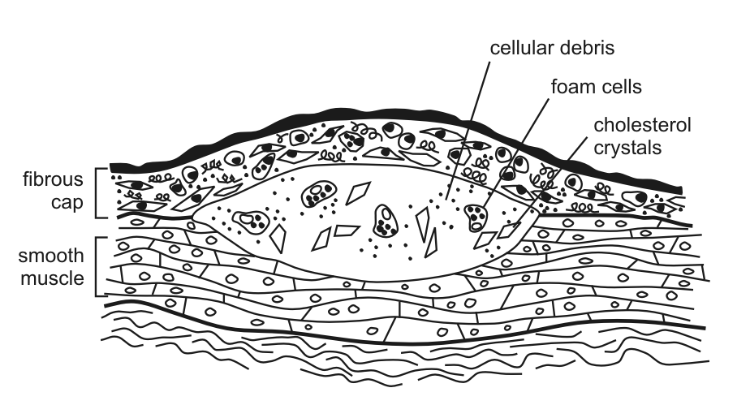
Atheroma

Slide 37
Likely indicators of vulnerable plaque
Histology:
Lipid/necrotic core.
Thin fibrous cap.
Haemorrhage into plaque.
Ulcerated plaque.

Slide 38
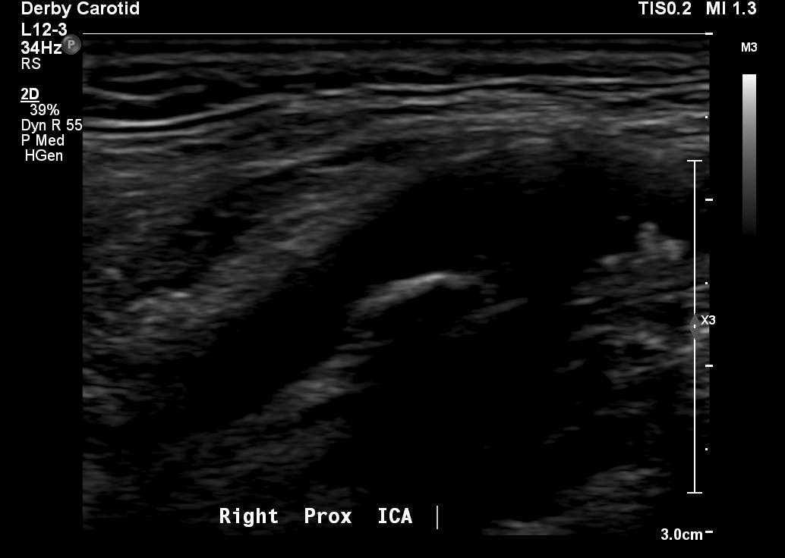
Example 1:

Slide 39
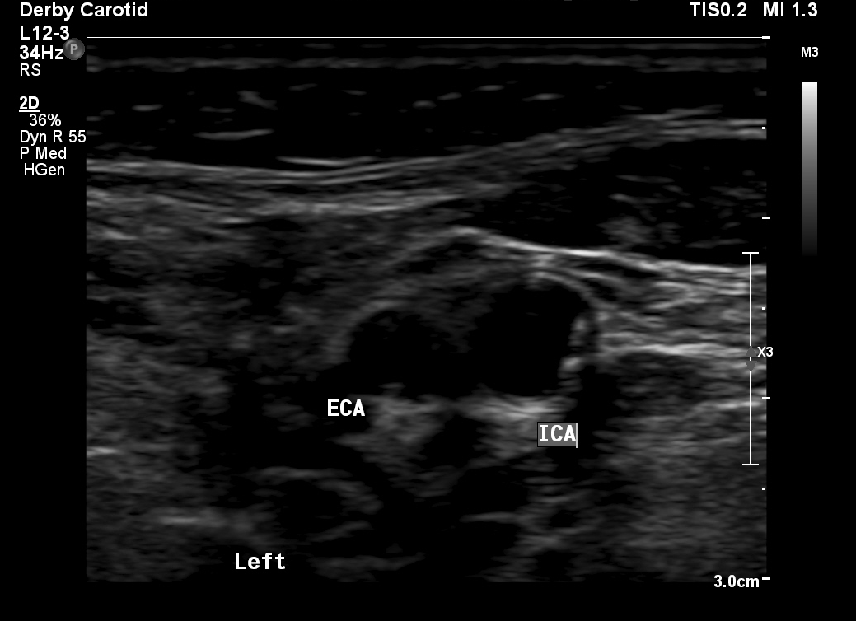
Example 2:

Slide 40
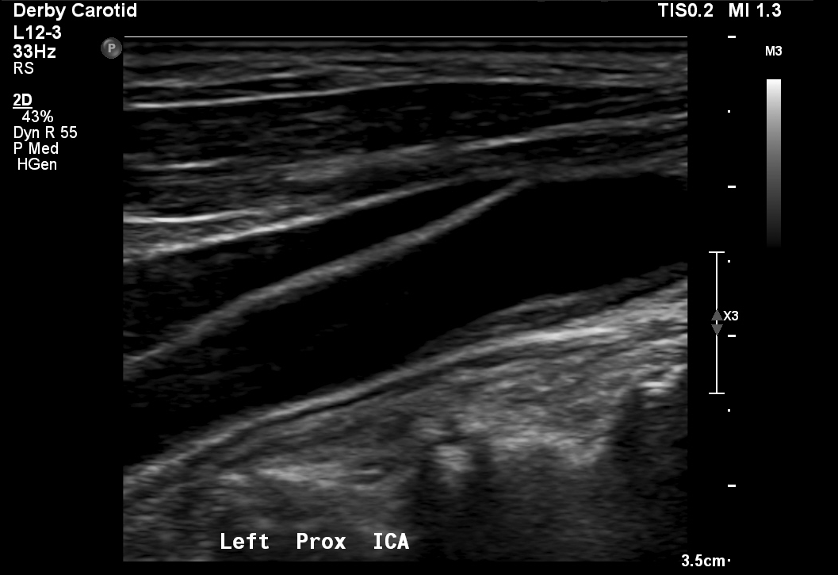
Example 3:

Slide 41
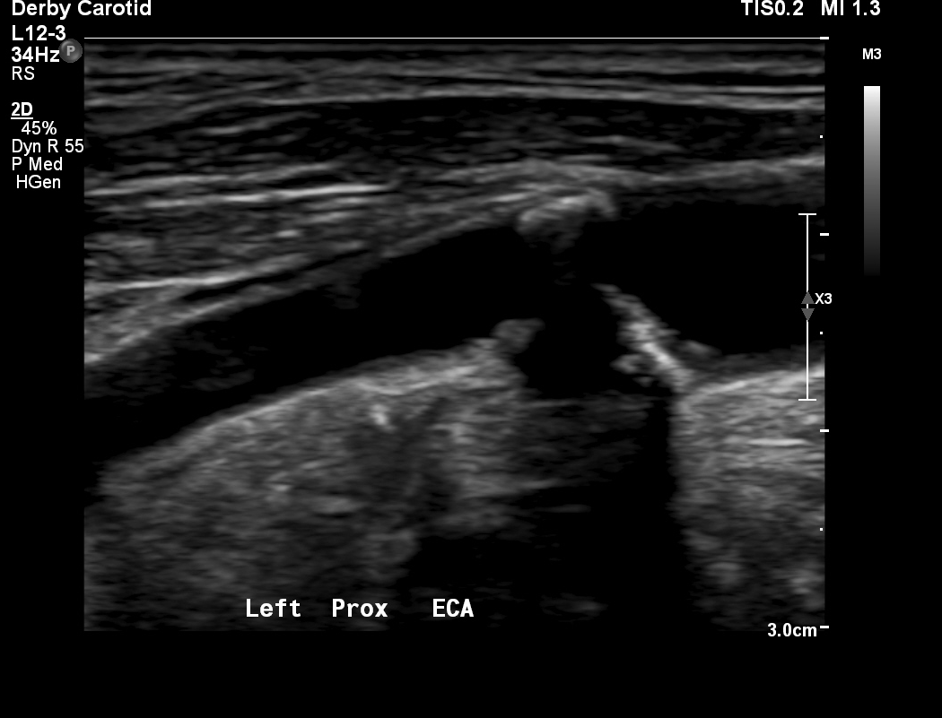
Example 4:

Slide 42
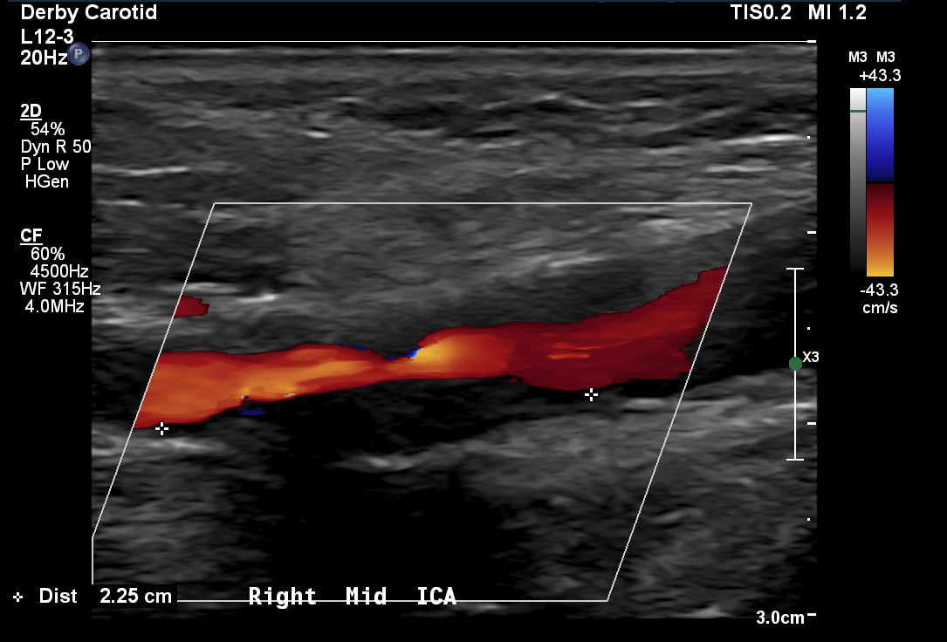
Example 5:

Slide 43
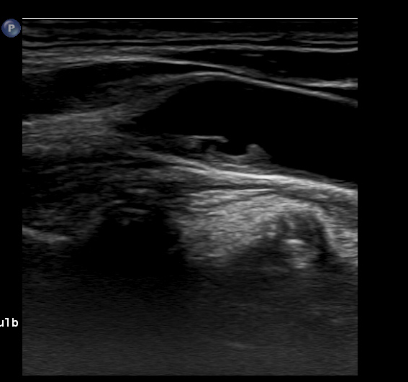
Example 6:

Slide 44
Johnson et al. 1985
Ways to characterise
Carotid plaques can be classified as follows:
Calcified
Dense (less hyperechogenic than calcified lesions)
Soft (isoechogenic in comparison with blood)

Slide 45
Grey-Weale Classification (1988) This is the first attempt at formal classification – key paper
Ways to characterise
Classification based on ultrasound appearance
I – uniformly echolucent with or without echogenic cap
II – predominantly echolucent (<50% echogenic area)
III - predominantly echogenic (<50% echolucent area)
IV - uniformly echogenic
V – unclassifiable (due to calcification)

Slide 46
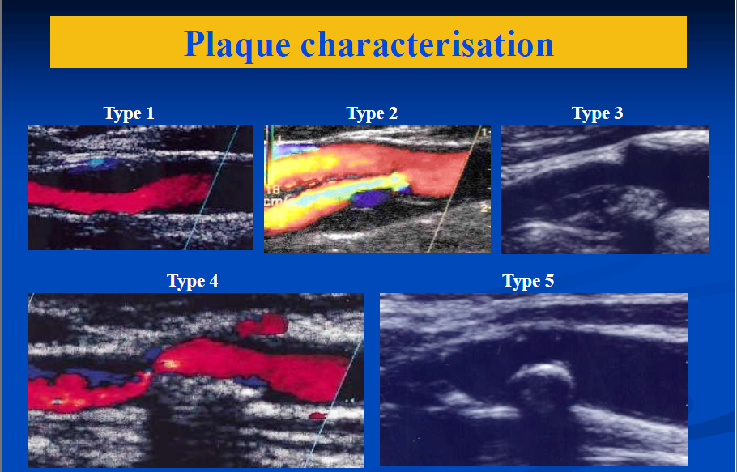
Grey-Weale Classification
Ways to characterise

Slide 47
Grey-Weale Simplified (2001)
Ways to characterise
Two level classification– hypo/hyperechoic
subjective
merge Grey-Weale types (G-W I,II vs III,IV)
found that hypoechoic more common in symptomatics
found that hyperechoic more common in asymptomatics

Slide 48
Hypoechoic
Hyperechoic
Notes:
ECHO LUCENT more problematic
“Background—We tested prospectively the hypothesis that stroke development can be predicted by echolucency of carotid
atherosclerotic plaques in previously symptomatic and asymptomatic patients.
Methods and Results—We followed incidence of ipsilateral ischemic strokes for 4.4 years in 111 asymptomatic and 135
symptomatic patients with >50% relevant carotid artery stenosis. At inclusion, echogenicity of carotid plaques and
degree of stenosis were evaluated with high-resolution B-mode ultrasound with computer-assisted image processing and
Doppler ultrasound, respectively. We observed 44 ipsilateral ischemic strokes. In symptomatic patients, relative risk of
ipsilateral ischemic stroke for echolucent versus echorich plaques was 3.1 (95% CI, 1.3 to 7.3), whereas for 80% to 99%
versus 50% to 79% stenosis, the relative risk was 1.4 (95% CI, 0.7 to 3.0). Relative to symptomatic patients with
echorich 50% to 79% stenotic plaques, those with echorich 80% to 99% stenotic plaques, echolucent 50% to 79%
stenotic plaques, and echolucent 80% to 99% stenotic plaques had relative risks of ipsilateral ischemic strokes of 3.1
(95%CI, 0.7 to 14), 4.2 (95% CI, 1.2 to 15), and 7.9 (95% CI, 2.1 to 30), equivalent to absolute risk increases of 11%,
18%, and 28%. This was not observed in previously asymptomatic patients.
Conclusions—Echolucent plaques causing $50% diameter stenosis by Doppler ultrasound are associated with risk of
future stroke in symptomatic but not asymptomatic individuals. This suggests that measurement of echolucency,
together with degree of stenosis, may improve selection of patients for carotid endarterectomy. (Circulation. 2001; “

Slide 49
Methods
Followed the incidence of ipsilateral ischemic strokes for 4.4 years in asymptomatic symptomatic patients with >50% relevant carotid artery stenosis.
Echogenicity of carotid plaques and degree of stenosis were evaluated with high-resolution B-mode ultrasound.
Notes:
“Background—We tested prospectively the hypothesis that stroke development can be predicted by echolucency of carotid
atherosclerotic plaques in previously symptomatic and asymptomatic patients.
Methods and Results—We followed incidence of ipsilateral ischemic strokes for 4.4 years in asymptomatic symptomatic patients with >50% relevant carotid artery stenosis.
Echogenicity of carotid plaques and degree of stenosis were evaluated with high-resolution B-mode ultrasound
In symptomatic patients, relative risk of ipsilateral ischemic stroke for echolucent versus echogenic plaques was 3.1 (95% CI, 1.3 to 7.3)
whereas for 80% to 99% versus 50% to 79% stenosis, the relative risk was 1.4 (95% CI, 0.7 to 3.0).
Compared to symptomatic patients with a echogenic 50% to 79% stenotic plaques for the risk of ipsilateral strokes:
echogenic 80% to 99% stenotic plaques have a relative risk of 3.1 (absolute risk of 11%) echolucent 50% to 79% stenotic plaques have a relative risk of 4.2
Echolucent 80% to 99% stenotic plaques had relative risks of 7.9
(95%CI, 0.7 to 14), 4.2 (95% CI, 1.2 to 15), and 7.9 (95% CI, 2.1 to 30), equivalent to absolute risk increases of 11%,
18%, and 28%. This was not observed in previously asymptomatic patients.
Conclusions—Echolucent plaques causing $50% diameter stenosis by Doppler ultrasound are associated with risk of
future stroke in symptomatic but not asymptomatic individuals. This suggests that measurement of echolucency,
together with degree of stenosis, may improve selection of patients for carotid endarterectomy. (Circulation. 2001; “

Slide 50
Results
For ipsilateral stroke in symptomatic patients:
The relative risk for echolucent vs echogenic plaques was 3.1 (95% CI, 1.3 to 7.3).
This is greater than the relative risk for 80-99% stenosis vs 50-79% stenosis, which was 1.4 (95% CI, 0.7 to 3.0)!!!
 | Echogenic 80-99% plaque | Echolucent 50-79% plaque | Echolucent 80-99% plaque
50-79% echogenic plaque | 3.1 (11%) | 4.2 (18%) | 7.9 (28%)
Relative risk (absolute risk)
Notes:
“Background—We tested prospectively the hypothesis that stroke development can be predicted by echolucency of carotid
atherosclerotic plaques in previously symptomatic and asymptomatic patients.
Methods and Results—We followed incidence of ipsilateral ischemic strokes for 4.4 years in asymptomatic symptomatic patients with >50% relevant carotid artery stenosis.
Echogenicity of carotid plaques and degree of stenosis were evaluated with high-resolution B-mode ultrasound
In symptomatic patients, relative risk of ipsilateral ischemic stroke for echolucent versus echogenic plaques was 3.1 (95% CI, 1.3 to 7.3)
whereas for 80% to 99% versus 50% to 79% stenosis, the relative risk was 1.4 (95% CI, 0.7 to 3.0).
Compared to symptomatic patients with a echogenic 50% to 79% stenotic plaques for the risk of ipsilateral strokes:
echogenic 80% to 99% stenotic plaques have a relative risk of 3.1 (absolute risk of 11%) echolucent 50% to 79% stenotic plaques have a relative risk of 4.2
Echolucent 80% to 99% stenotic plaques had relative risks of 7.9
(95%CI, 0.7 to 14), 4.2 (95% CI, 1.2 to 15), and 7.9 (95% CI, 2.1 to 30), equivalent to absolute risk increases of 11%,
18%, and 28%. This was not observed in previously asymptomatic patients.
Conclusions—Echolucent plaques causing $50% diameter stenosis by Doppler ultrasound are associated with risk of
future stroke in symptomatic but not asymptomatic individuals. This suggests that measurement of echolucency,
together with degree of stenosis, may improve selection of patients for carotid endarterectomy. (Circulation. 2001; “

Slide 51
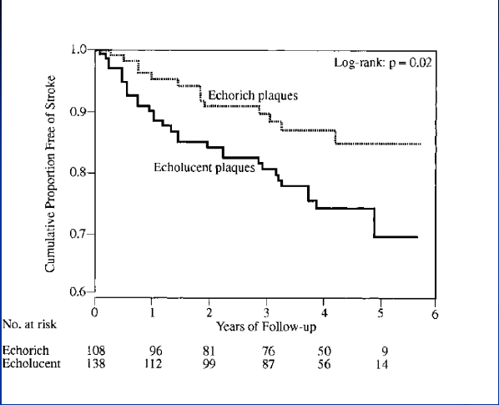
Notes:
“Background—We tested prospectively the hypothesis that stroke development can be predicted by echolucency of carotid
atherosclerotic plaques in previously symptomatic and asymptomatic patients.
Methods and Results—We followed incidence of ipsilateral ischemic strokes for 4.4 years in asymptomatic symptomatic patients with >50% relevant carotid artery stenosis.
Echogenicity of carotid plaques and degree of stenosis were evaluated with high-resolution B-mode ultrasound
In symptomatic patients, relative risk of ipsilateral ischemic stroke for echolucent versus echogenic plaques was 3.1 (95% CI, 1.3 to 7.3)
whereas for 80% to 99% versus 50% to 79% stenosis, the relative risk was 1.4 (95% CI, 0.7 to 3.0).
Compared to symptomatic patients with a echogenic 50% to 79% stenotic plaques for the risk of ipsilateral strokes:
echogenic 80% to 99% stenotic plaques have a relative risk of 3.1 (absolute risk of 11%) echolucent 50% to 79% stenotic plaques have a relative risk of 4.2
Echolucent 80% to 99% stenotic plaques had relative risks of 7.9
(95%CI, 0.7 to 14), 4.2 (95% CI, 1.2 to 15), and 7.9 (95% CI, 2.1 to 30), equivalent to absolute risk increases of 11%,
18%, and 28%. This was not observed in previously asymptomatic patients.
Conclusions—Echolucent plaques causing $50% diameter stenosis by Doppler ultrasound are associated with risk of
future stroke in symptomatic but not asymptomatic individuals. This suggests that measurement of echolucency,
together with degree of stenosis, may improve selection of patients for carotid endarterectomy. (Circulation. 2001; “

Slide 52
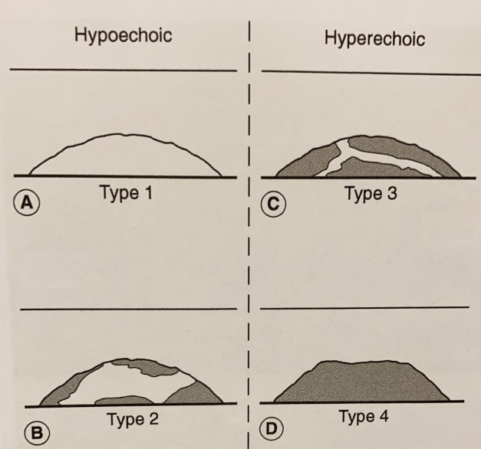
Vascular ultrasound textbook
An international consensus meeting (de Bray et al 1997). Methods for describing plaque features should include the following:
Echogenicity.
Surface (smooth/cavitated)
Texture (homogenous/
heterogeneous)
Homogenous
Heterogeneous
Heterogeneous
Homogenous

Slide 53
SVT guidelines
B-mode should be used to classify echogenicity.
B-mode should also be used to classify surface characteristics.
- Smooth/regular
- Irregular
- Ulcerated

Slide 54
Thoughts?

Slide 55
Audits

Slide 56
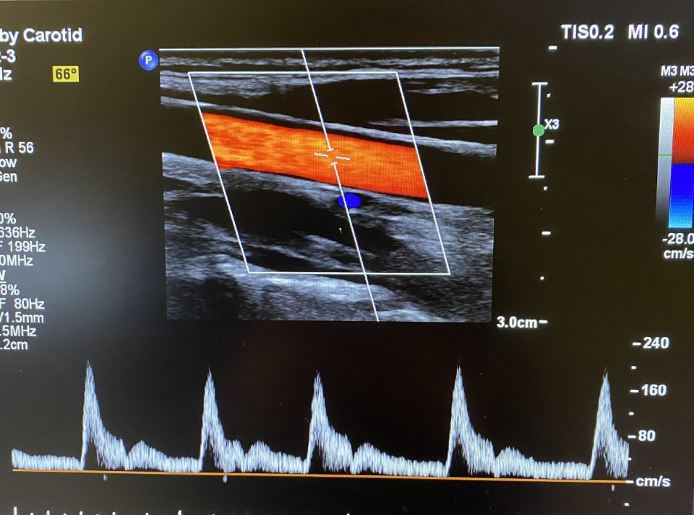
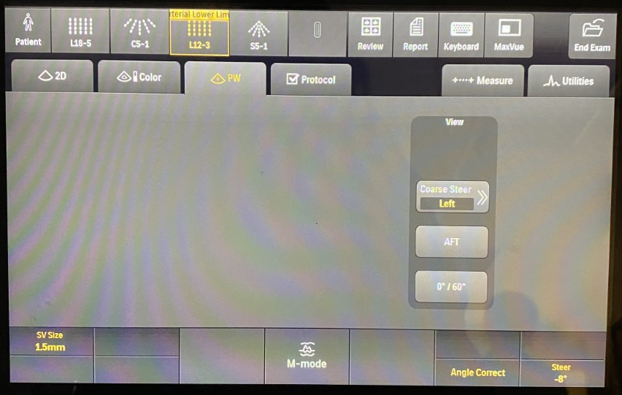
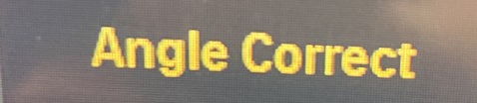
Angle
DO NOT CHANGE THIS, UNLESS YOU ABSOLUTLEY CANNOT GET THE CORRECT ANGLE!!!
Notes:
I.E when ICA dives deep. Even then, the angle should still be kept between 45 and 60 degrees.

Slide 57
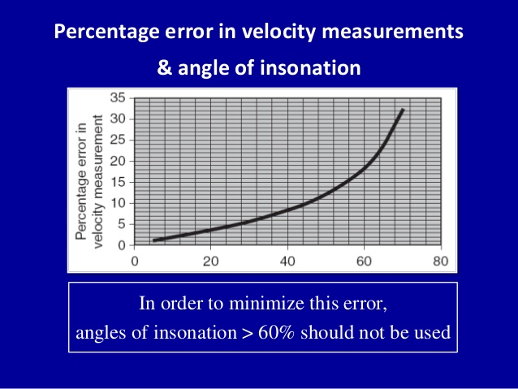
Why?
High rate of error in angles greater than 60.
Over estimation of the velocities.
Ideally, the angle of isonation should be zero to minimise errors BUT peripheral vessels often lie parallel to the skin, so this is not possible.
If velocity ratios are calculated using two velocity measurements made with significantly different angles of isonation, significant errors may be introduced.
So we keep angle of isonation at 60 to standardise scanning, therefore minimising errors in velocity measurements.
Notes:
In reality, it probably wont make a huge difference to the measured velocities, however an angle over 60 degrees leads to the over-estimation of velocities.

Slide 58


The correct way to do it…

Slide 59
High Q
Makes velocity measurements quick and easy, and is okay to use for ‘clean waveforms’ But…
It is a short cut and should not be used.
For all velocity measurements, the calipers should be used.
Why?
Artefact and turbulence – overestimation of velocities.

Slide 60


Slide 61

High Q
Caliper measurement
Makes velocity measurements quick and easy. But…
It should not be used, the calipers should be used to make velocity measurements.
Why?
Artefact and turbulence – overestimation of velocities.

Slide 62

Graft surveillance
Clinical history is extremely important
From 6 weeks onwards, patients do not see the Vascular consultants, they only see us!
Therefore, it is our responsibility to take a detailed clinical history and report this for EVERY surveillance, so it can be compared between scans, for example:

Slide 63

Depth
Too much depth on images…

Slide 64
Colour
Colour gain is consistently too high, with bleeding of the colour out into the tissues.
Filling should be wall-to-wall only.
Gain is often increased when filling is difficult rather than the PRF!
PRF is not changed enough throughout the scan.
We need to make better use of colour gain and scale when scanning i.e. reducing scale when low flow, changing the wall filter and using low flow mode.

Slide 65

Colour

Slide 66

Colour
Scale too high

Slide 67
Wording…
‘There is a 50% stenosis in the mid vessel with increased flow to PSV ….m/s’
Flow may actually DECREASE across a stenosis.
The velocity INCREASES.
So we need to make it clearer i.e:
There is a 50% stenosis in the mid vessel with velocities increasing from PSV …m/s to PSV …m/s.

Slide 68
Trainee update:

Slide 69
Any other miscellaneous business

