Slide 1
Vascular meeting
Agenda:
Bacon and Sausage
Conference Feedback (Ryan)
TOS
Carotid web plaques
NAASP
Schedules
Vetting
Nicky updates
Audit /machine trials
Pre-op V06
Vascular Social

Slide 2
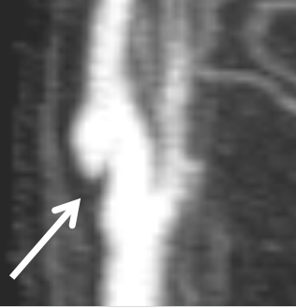
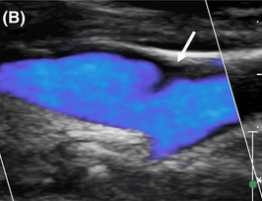
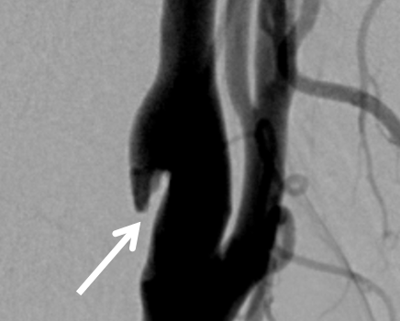
Carotid Web

Slide 3
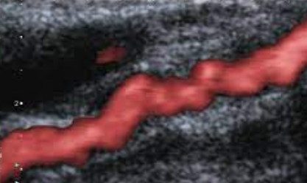
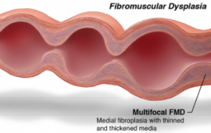
What is it?
A rare form of fibromuscular dysplasia (FD).
Non-atherosclerotic, non-inflammatory disease
that results in the abnormal growth in any
of three arterial layers.
Why rare? The more common form of
FD presents as:
BEADS
BEANS

Slide 4
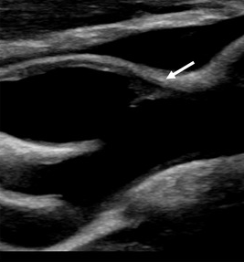
What does it look like?
Typically ‘shelf like’ lesion corresponding to a single focal dysplasia.
A ‘small, membrane-like, linear filling defect projecting into the ICA lumen’.

Slide 5
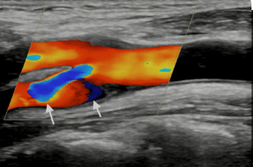
What’s the problem?
Stenosis – but unlikely
Turbulent/stagnant flow behind the web
Elevated risk of initial and recurrent ipsilateral stroke
Even in absence of stenosis and with antiplatlet +/- anticoag treatment!

Slide 6
Treatment

Slide 7
Differential diagnoses
Atherosclerosis
Typically more echogenic.
Tends to not have a hyperechoic nidus/spur
Webs may have ‘hypoechoic edging on the
lower side’ – ?intima and blood interface

Slide 8
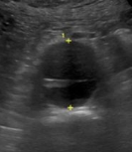
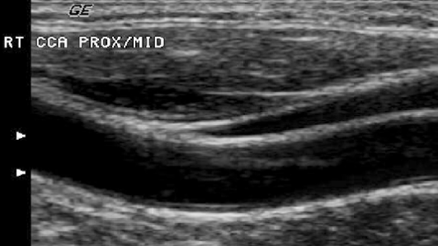
Dissection
Can be motile whereas webs will not be.
Echogenic vs hypoechoic

Slide 9
What to do if you suspect a web
Always report!

Slide 10
NAASP
As of beginning January:
The NAASP backlog was ~130 patients
This is a 4-6 month wait (no February NAASP service)
So we have said we will do 4 sessions in Feb, giving ~60 slots over next few weeks.
This almost halves the waiting list – but importantly makes sure it is just 24 month surveillance patients that are still waiting.
After this we will wait and see. Hopefully they can self maintain from there, if not we can react on an ADHOC basis?

Slide 11
Schedules
Why did it need changing?
Ryan and Alannah don’t need supervision or training slots
Ryan and Alannah changed their working hours.
= Huge increase in capacity which was underutilised.
There was also no route for urgent patients to have their referrals expedited rapidly
(I will come back to this)
The initiation of this coincided with Linzi and I being off and with Jodie just starting to get involved with Vascular. So it has probably been a bit bumpier than anticipated, but it has also been initiated a lot later than hoped. So yes, there are a few teething problems, but we are getting there.

Slide 12
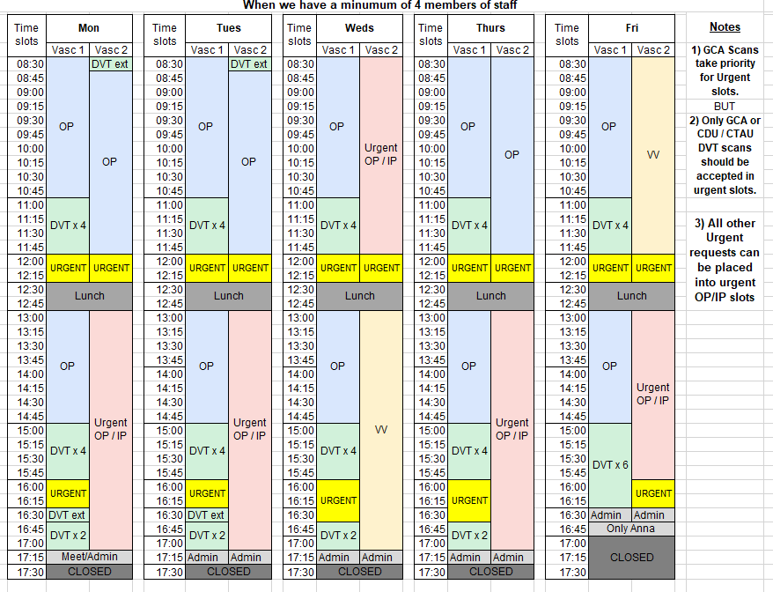

This new system is based on the assumption that half of the time in these slots is for:
IP (Min 2 hours)
If there are more urgent referrals then these can also be booked into a normal OP slot wherever available.

Slide 13
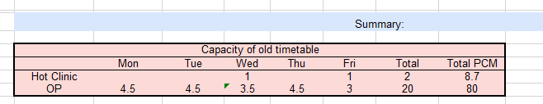
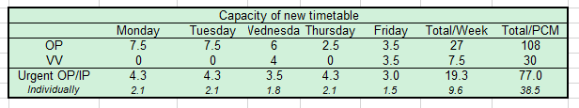
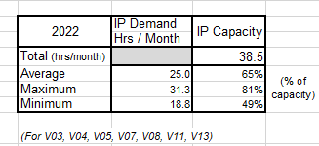
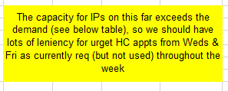

Schedules

Slide 14
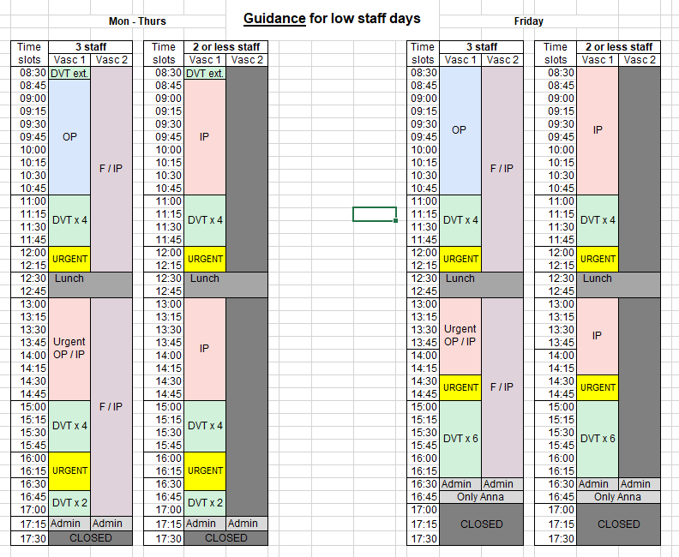
Schedules

Slide 15
Vetting
So for this system to work, it is slightly dependent on urgent referrals actually being urgent.
So when we are vetting we need to have a look to make sure that they are clinically indicated as urgent.
If there is no clinical information indicating that they are urgent written down (? minus vascular consultants), should we put these in routine slots?
What do we think?
I am going to do a small project to assess routine and urgent patients. I will feed this back at the next meeting.

Slide 16
Vetting
Also a reminder from Linzi's email
If we notice that patients reside in chesterfield, write this on the referral so that she can send the referral up there instead ☺

Slide 17

Audits

Slide 18
Current audit themes
Frozen DVT images
Proof reading reports
I have noticed frozen DVT and Varicose vein images.
I don’t think that we shouldn’t be taking frozen images for these scans, I think that dynamic images show a lot more and can be more easily audited.
What are everyone's thoughts on this? We should all be on the same page and doing the same thing.
Make sure that reports are thoroughly proof read to ensure accurate velocities and that the summary does not contradict the main body of the report.
Also ensure that the correct leg has been reported / that the side of the body scanned has been specified.

Slide 19
Current audit system
Audit frequency
Number of scans audited
Everyone is audited every 3 months. These are for the following scans:
DVT
Carotid
Arterial
For each type of scan audited, 4 scans are chosen at random.
The scores from these 4 scans are averaged to get an overall monthly score for that particular modality (i.e. DVT)

Slide 20
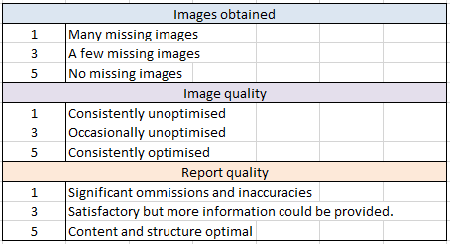
Scoring system

Slide 21
New audit system
The frequency of audit will stay the same (every 3 months).
The scoring system and number of scans for each person will also remain the same.
Feedback will be given via email each time you are audited (so every 3 months).

Slide 22
New audit system
Average scores below 10
Scores below an expected standard
We should aim to have an average score above 10.
We should aim to have a score above 2 for each individual element of a scan (images obtained, image quality, report quality).
Individuals with scores below 10 will be audited every month for a period of 2 months.

Slide 23

New audit system
After the 2-month period if scores haven’t improved what should happen?

Slide 24

New audit system
My thoughts…
1 to 1 Seminar to demonstrate where image / report quality could be improved.
Additional training offered if an individual feels they need support with something specific.
Audited for another 2 months after this to see if this has helped.
Disputes – if an individual does not agree with their audit scores, the images could be reviewed by another person.

Slide 25

Ryan will now be helping
me with auditing.

Slide 26
Machine trials
Mindray
Siemens / GE
Have finally chased them down!
Hopefully we can get the machine in to trial in March.
We will just trial one machine which could be used as both a portable and mainframe.
The general consensus was that neither stood out or matched the image quality of the Philips.
Is that correct?
Both have expressed interest in us re-trialling them as they have said the issues we raised could be addressed.
Would anyone like to re-test them once we’ve had Mindray in?

Slide 27

Machine trials
Samsung
I have spoken to the sales rep for Samsung
The machine is not ‘made specifically’ for Vascular but they are currently developing it to be used for Vascular
Is anyone interested in trialling it?

Slide 28

Alannah Pre-CABG carotid duplex

Slide 29
Pre-CABG carotid duplexes
Seems like we are getting more requests.
Patients haven’t been confirmed to be suitable for surgery.
Doesn’t seem to be a clear guideline to follow.

Slide 30
Pre-CABG carotid duplexes – currently
Have been given data, now need to analyse to get facts.
Have been given contacts in cardiology.
Utilising journals.
Any recommendations on how to approach this?

Slide 31




Next Vascular Social Options
Any other suggestions?

